Slide 1
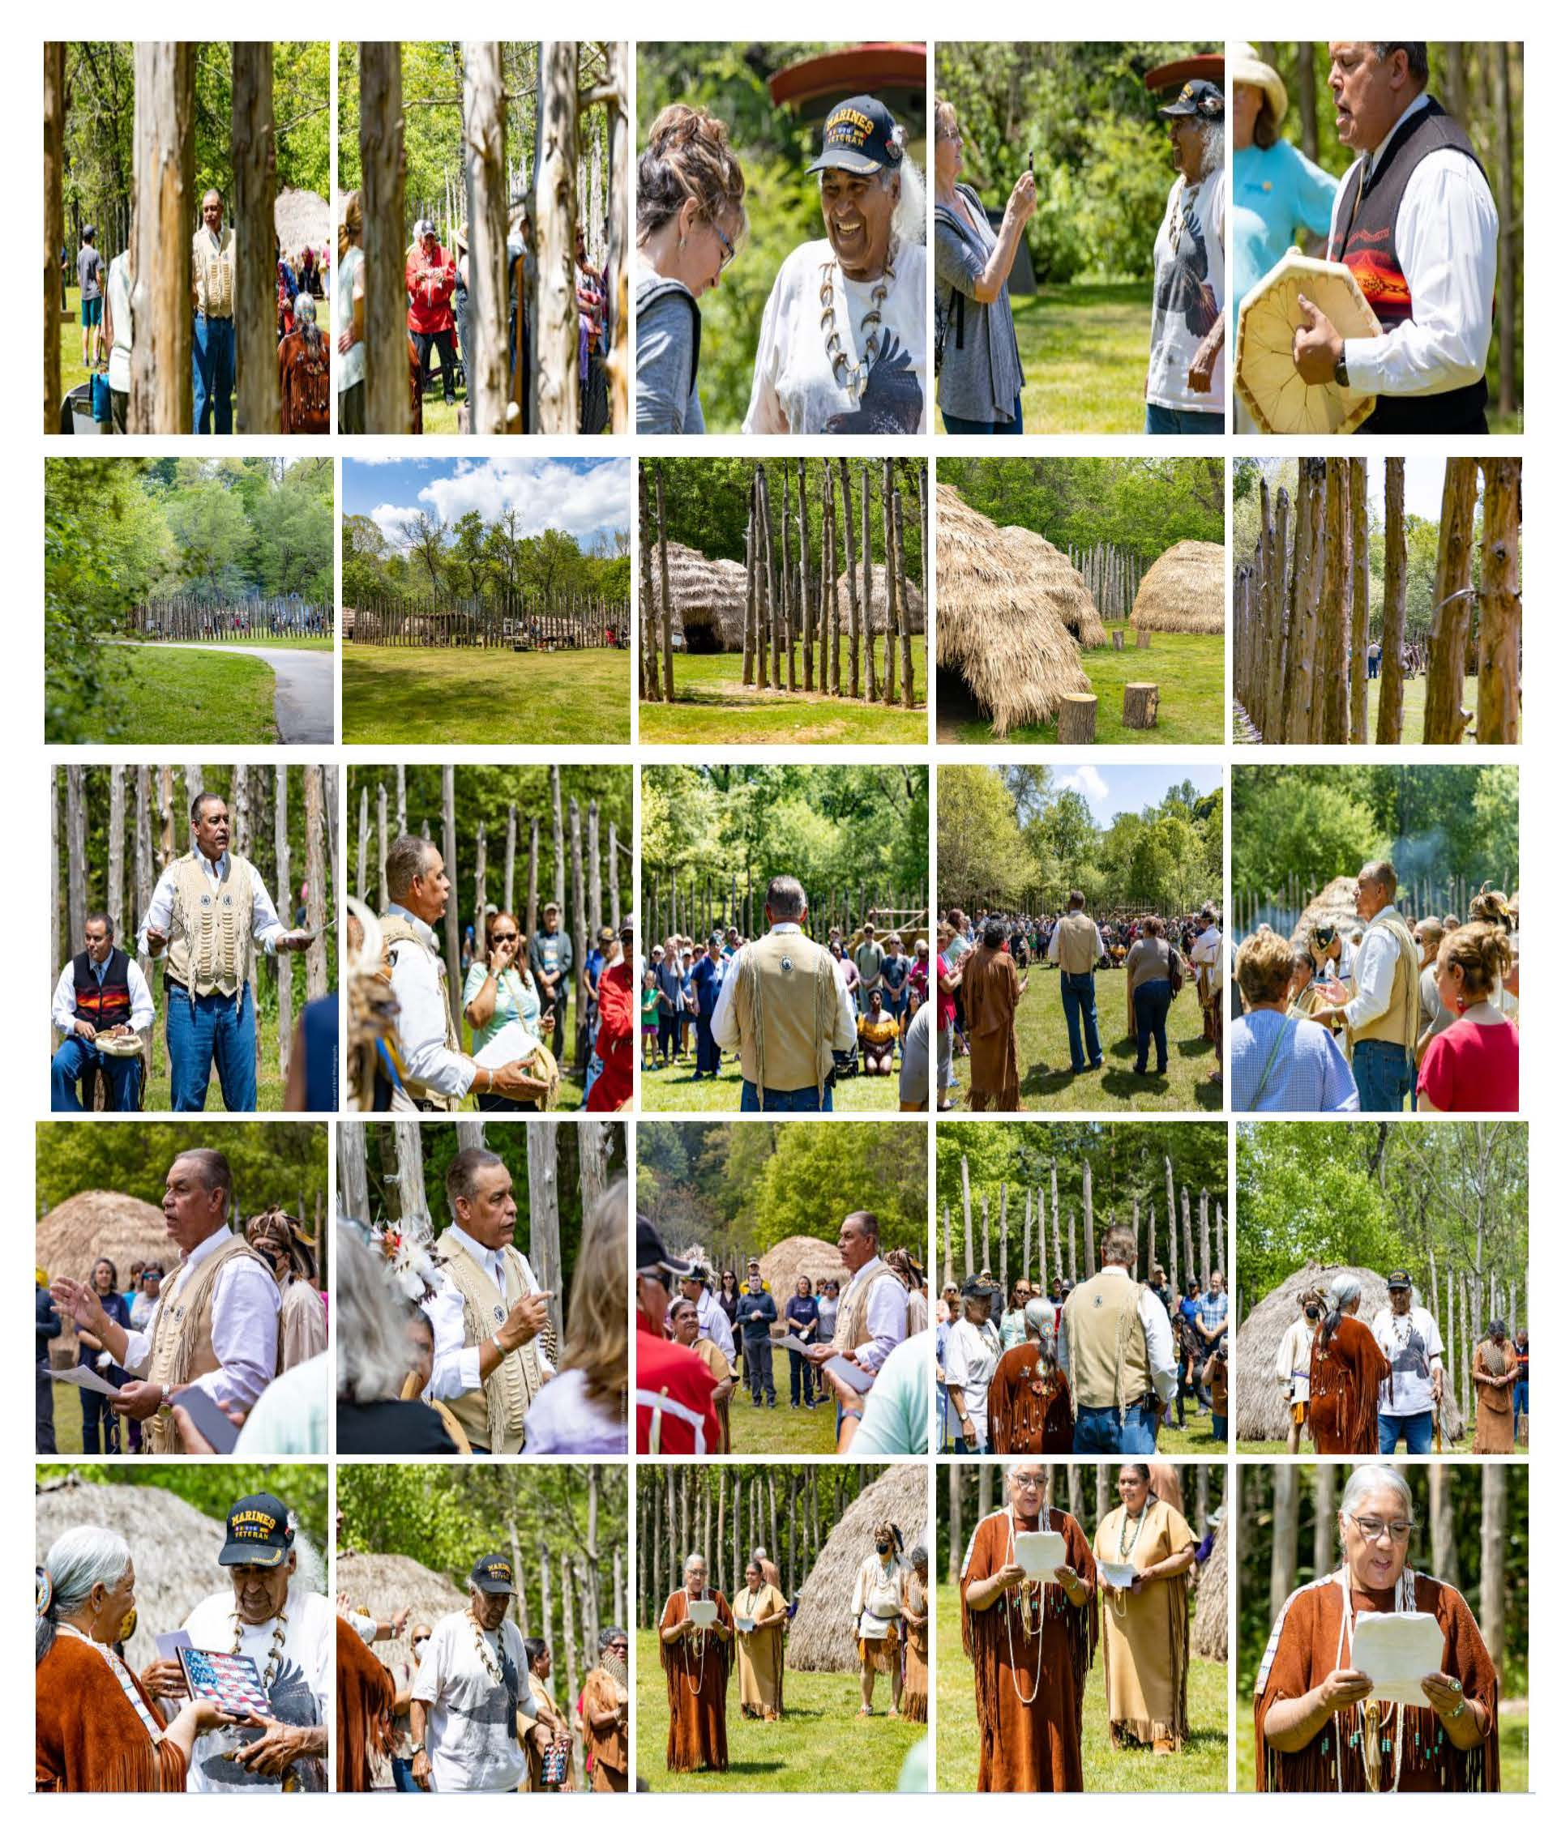
Shared People, Shared Interests
Connecting Counties and Our American Indian Organizations
*Photo: Rededication of Hillsborough Village
Occaneechi Band of the Saponi Nation
Native People of Alamance, Caswell, and Orange Counties
April 2022.

Slide 2
Domains of public service leadership
You Are Here
Community
Organizational
Interpersonal
Personal

Slide 3
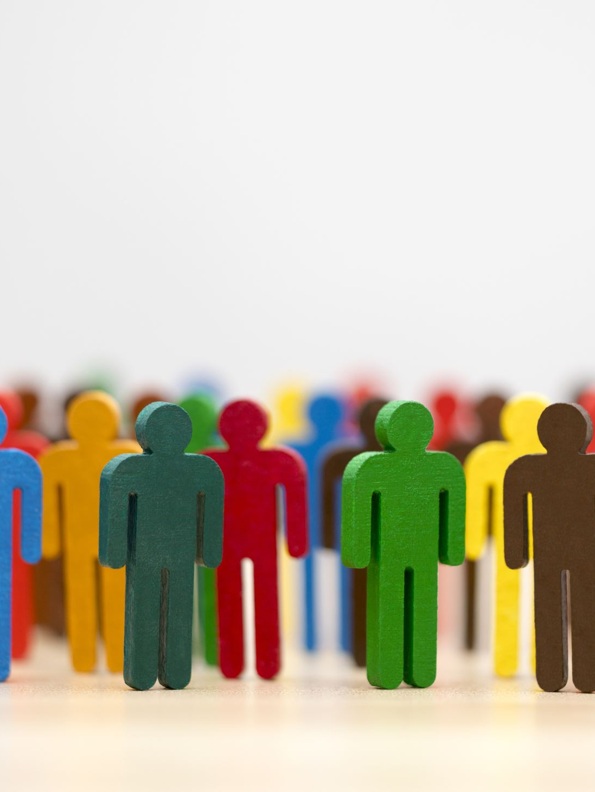
Com﮲mu﮲ni﮲ty
Definition of community
1: a unified body of individuals: such as
a. the people with common interests living in a particular area; broadly, the area itself
b: a group of people with a common characteristic or interest living together within a larger society

Slide 4
WANTED: COMMUNITY LEADERS
JOB DESCRIPTION:
“A PERSON WHO WORKS WITH OTHERS TO DEVELOP AND SUSTAIN THE HEALTH OF THE COMMUNITY”
Notes:
Core competencies for community leadership (Community Leadership Handbook, (James F. Krile, with Gordon Curphy and Duane R. Lund
Framing Ideas
Building social capital
Mobilizing resources

Slide 5
What is a “Healthy Community?
A place where all people can meet their economic, social, physical, cultural, and spiritual needs; work together for the common good; and participate in creating their future

Slide 6
