Slide 1


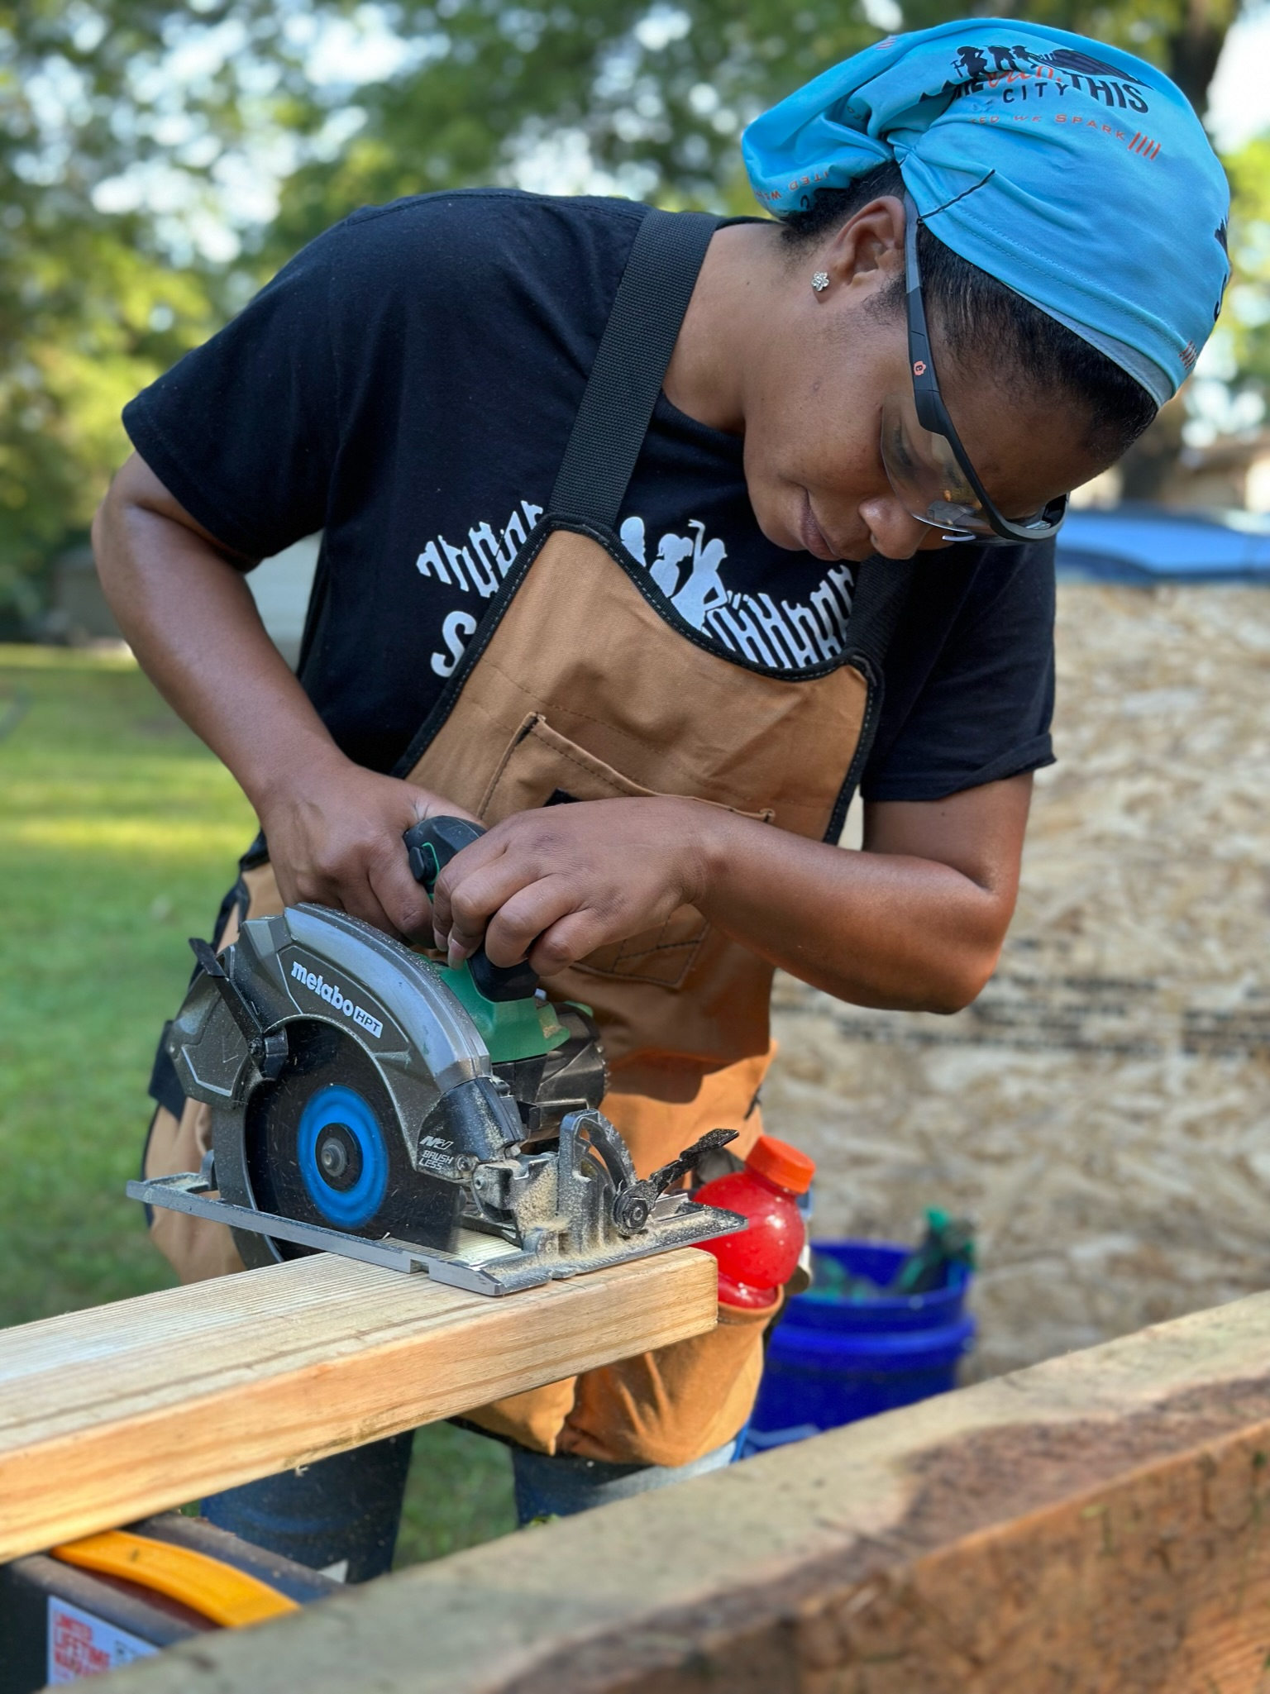


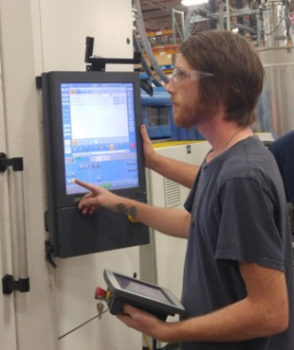

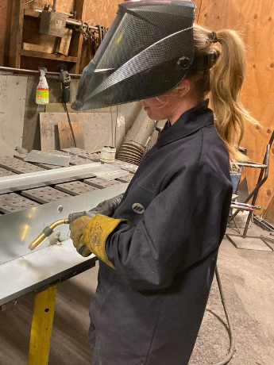
Uniting Forces & Fueling Success!

Slide 2


Economic Development Division of Community College System
Economic Development Division: Business facing elements of the NCCCS. Workforce development is economic development because workforce is the number one driver in a company's decision of where to locate.
NCEdge Customized Training: Tailored and adaptable training available to new or existing industry based on their workforce needs.
Small Business Center Network: Business counseling, seminars and classes, resource and referral services for entrepreneurs.
BioNetwork: Education and training for all life science industries, from food and beverage to biotechnology.
ApprenticeshipNC: The U.S. DOL sanctioned State Apprenticeship Agency responsible for regulating and growing registered apprenticeship programs.
Economic Development
Small Business Center Network
ApprenticeshipNC
Customized Training
Bio Network

Slide 3
ANC – The State Apprenticeship Agency (SAA)
Constituents include the entire state – all employers regardless of where they obtain their related instruction.
Apprenticeship codified in 1937 with the Fitzgerald Act. Governed by 29 CFR parts 29 and 30.
NC GS 115D Article 1A (115D-11.5 thru 115D-11.14)
As an SAA state we are the responsible body to register, regulate, and audit all registered apprenticeship programs in the state. Non-SAA states are regulated directly by U.S. DOL.
Our primary interaction is with the sponsor/employer (we collaborate with the entire workforce ecosystem).
Major elements of apprenticeship include:
  Program registration
  Apprenticeship registration
  Audits (provisional, quality, and EEO)
  Revisions
  Completion
  Cancellation (program, apprentice)

Slide 4
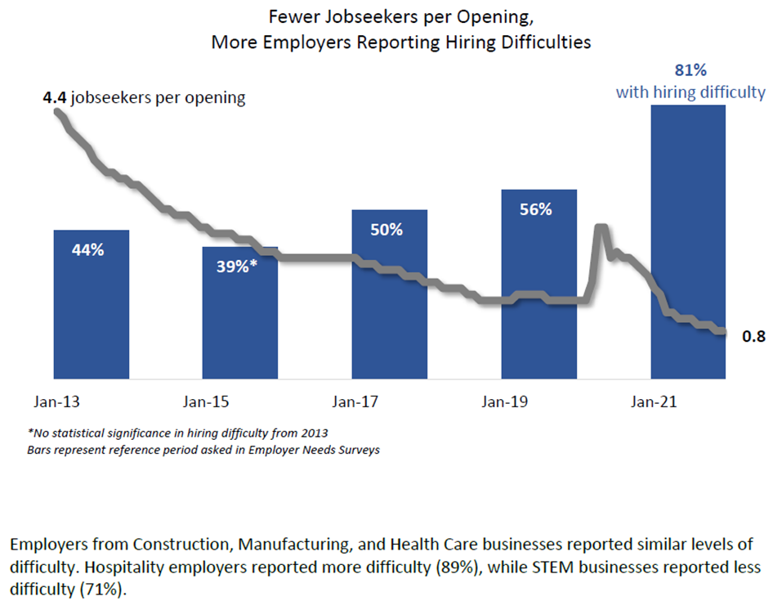
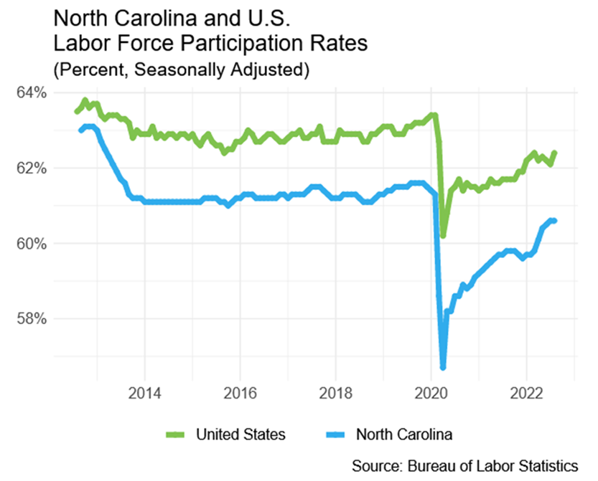
Background

Slide 5
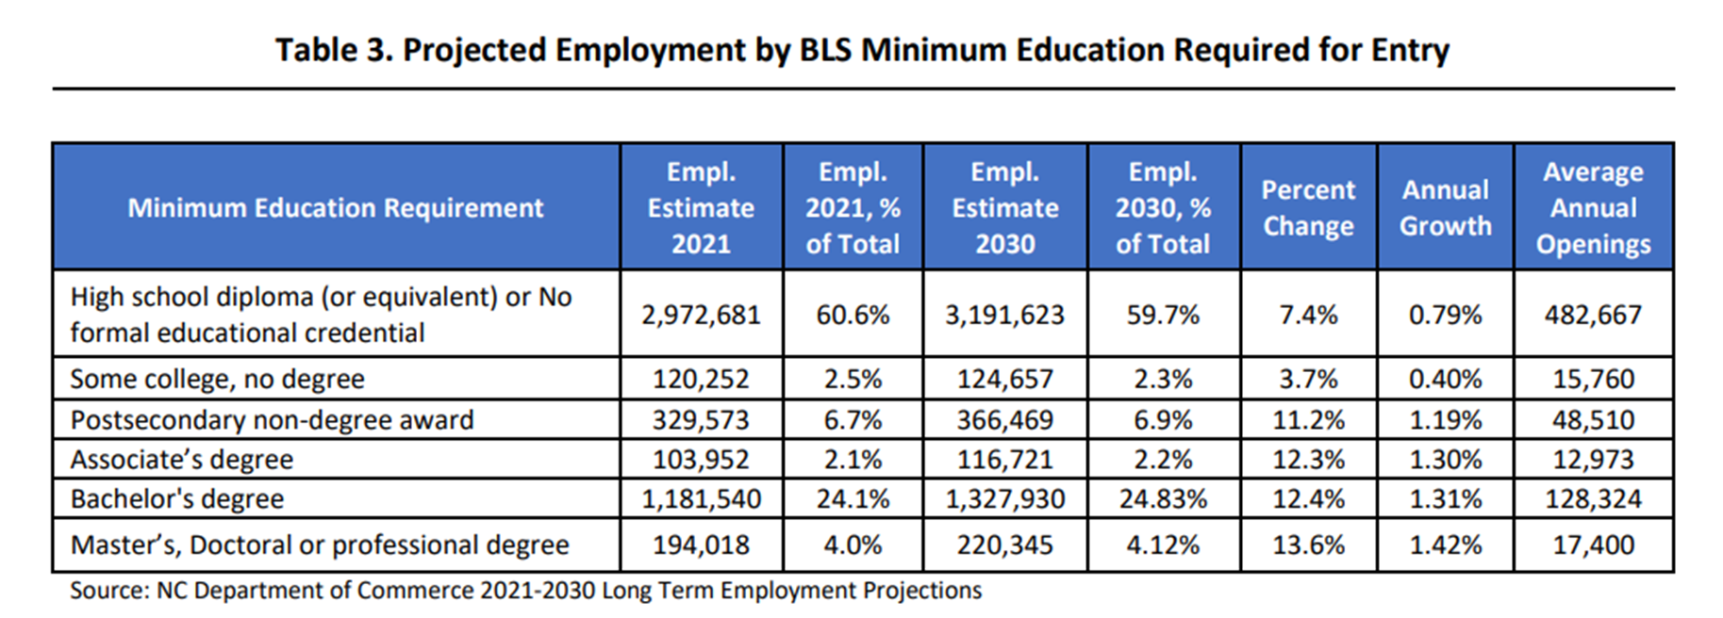
Level of Education Required for Jobs

Slide 6
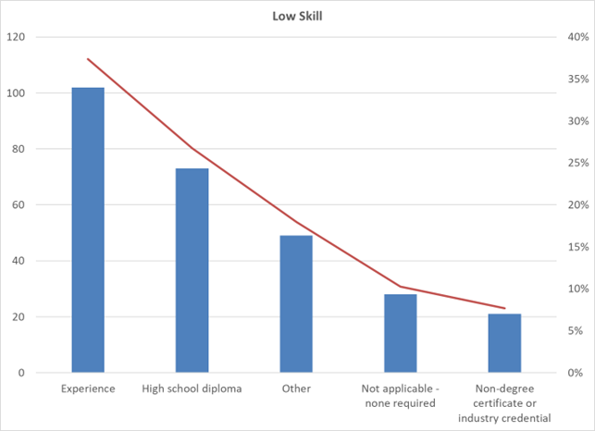
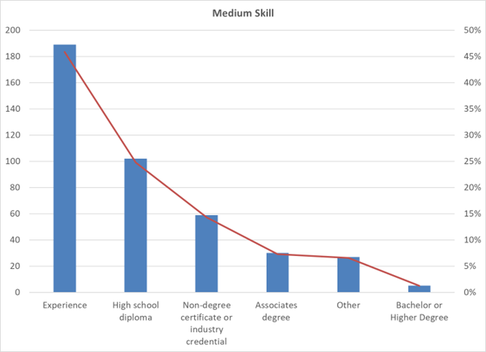
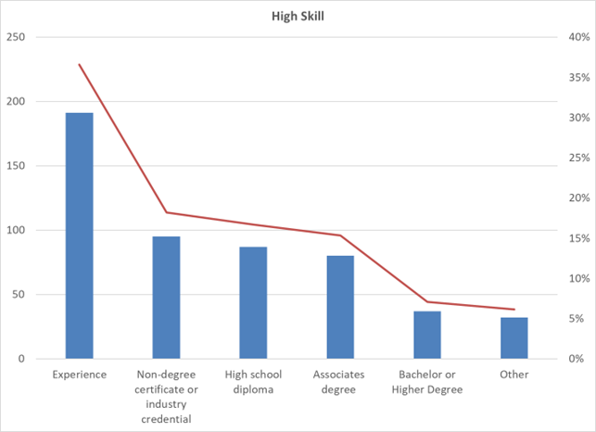
Across All Skill Levels – Experience is Most Frequently Identified Credential Employers Desire

Slide 7



What do Employers Want in Employees?
Hard to acquire in a classroom!
Basic Employment Skills
Industry Specific
Skills
Company Specific
Skills
Growth Mindset
Notes:
Basic employment skills – show up to work on time, be respectful, teamwork…
Skills critical in 21st century
Leadership
Personal Responsibility & Self Organization
Ability to judge new and/or complex situations
Critical Thinking & Problem Solving
Collaboration & Teamwork
Adaptability
Communication
Empathy
Continuous Learner

Slide 8
What is a Registered Apprenticeship?
Gold Standard in WBL
Career Exploration
Skill Development
Field Trips & Site Visits
Internships
Job Shadow
On the job training
Apprenticeship Like
Registered Apprenticeship
Externships
Registered apprentice programs are the gold-standard for work-based-learning.
Elements must include:
  Employer
  Participant
  Mentor
  Related Instruction
  Paid
  Registered with SAA or DOL
  Pre-determined criteria
    Time Based
    Competency Based
    Hybrid
Registered Apprenticeship is a Skill Development Solution!

Slide 9

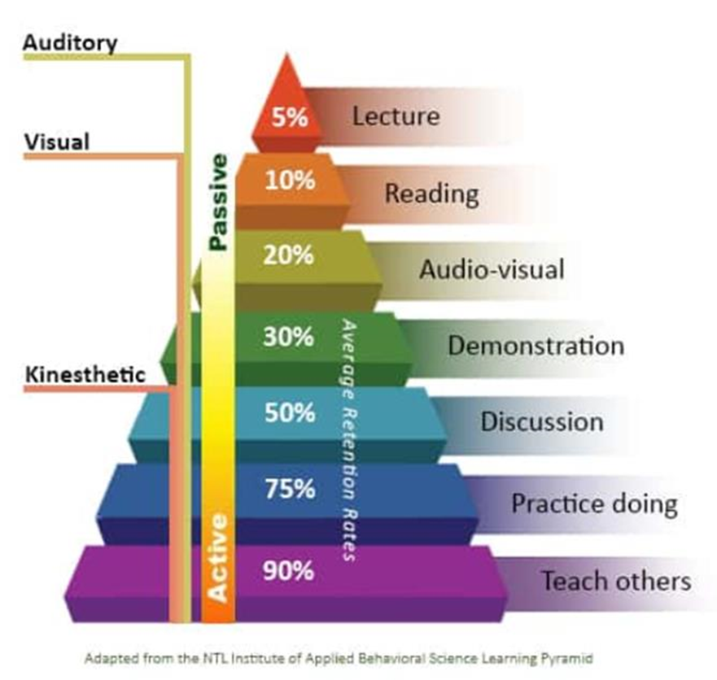
Win – Win – Win
Apprentices earn an average of over $300,000 more
High ROI for Business ($1.47 to $2.00 for every $1.00)
High ROI for state and federal funds ($23 to $27 for every $1)
Completion rate of those entering a program is 70% - 80%
Retention rate of completers 90% five years post program
Retention rates of Internships is 15% to 39%
122,000 North Carolina high school graduates annually

Slide 10





Five Core Components of Registered Apprenticeship
BUSINESS INVOLVEMENT
Programs are employer led and customized to their business.
STRUCTURED ON-THE-JOB TRAINING
Apprentices receive on-the-job training from an experienced mentor.
RELATED
INSTRUCTION (RI)
This is classroom, theory, or other supplemental training that works with the on-the-job training.
REWARDS FOR SKILL GAINS
Apprentices are employees and receive increased wages as their skills increase.
OCCUPATIONAL CREDENTIAL
Completers receive a U.S. DOL and State certificate documenting their occupational competence.

Slide 11








Registered Apprenticeship Works Across Industries
Healthcare
Manufacturing
Construction
Hospitality & Transportation
Trade & Logistics
Information Technology
Energy
Education

Slide 12





Registered Apprenticeship Works Across Demographics
Women – Non-Traditional Roles
Exiting Military & Veterans
Justice Served
Persons with Disabilities& Transportation
Youth, Young Adult, & Adult – New or Incumbent

Slide 13
Apprenticeship Approaches
Time
Competence
Hybrid
Program is developed so that after a prescribed period the participants will have mastered necessary skills.
Program is developed with a skill competency checklist that a participant must master to become certified.
Program is a combination of time and competency.
Both must be achieved to become certified.

Slide 14
Apprenticeship Program Models
Traditional
Intermediary/Sponsor
Consortium
Employer registers program and occupation(s).
Employer recruits participant(s).
Employer registers participant(s).
Apprentice completes program.
Apprentice receives occupation certificate and may earn other credentials.
Sponsor registers program and occupation(s).
Sponsor recruits employers
Employers signs agreement to terms of program.
Sponsor and/or employer recruits participant(s).
Sponsor registers participant(s).
Apprentice completes program.
Apprentice receives occupation certificate and may earn other credentials.
Consortium organizes – K12, College, Employer(s).
Consortium recruits employers.
Employer registers program and occupation(s).
Consortium recruits participants (typically includes orientation, selection, and pre-apprenticeship)
Employer registers participant(s).
Apprentice completes program.
Apprentice receives occupation certificate and may earn other credentials.

Slide 15
Pre-Apprenticeship Program Models
Consortia
Skill Development
Contingency
Typically used to ensure good fit between employer and apprentice before entering long-term apprenticeship.
This program is typically used to develop career, technical, or life skills
This program is often used by related technical instruction providers to prepare completers for employment and/or enrollment in apprenticeship.

Slide 16
Current Situation & Potential
Employers and workers are often unaware of options available.
Many counties do not have an aligned workforce eco-system working together to achieve a common goal.
Surry-Yadkin Works is exemplar for a few reasons:
  Eco-system came together to solve a problem
  Two counties, community college, four public school systems, and employers.
  County commissioners funded program so that there are dedicated resources, and it is sustainable.
  Performance is closer to Europe than U.S.

Slide 17
QUESTIONS?

