Slide 1
Next NC Scholarship
Presentation to NC Association of County Commissioners Public Education Steering Committee
JUNE 2024

Slide 2
NCSEAA: HELPING NC PAY FOR EDUCATION
Higher Ed. Grants and Scholarships
Career-Specific Programs
Residency Determination Service
Nonpublic K12 Scholarships
Education Loans
529 Savings Plans
College Foundation of North Carolina
2

Slide 3
NEXT NC SCHOLARSHIP

Slide 5
NC STUDENT AID STUDY GROUP 2018-2019
Purpose
Evaluate primary state grant programs that serve NC’s public college students
Process
Assessed NC grant programs’ strengths and weaknesses
Heard from national experts in student financial aid practices across the country
Gathered lessons learned through research and best practices in other states
Outcomes
Based on its findings, the Aid Study Group developed evidence-based reforms to enhance the effectiveness of state aid investments.

Slide 6
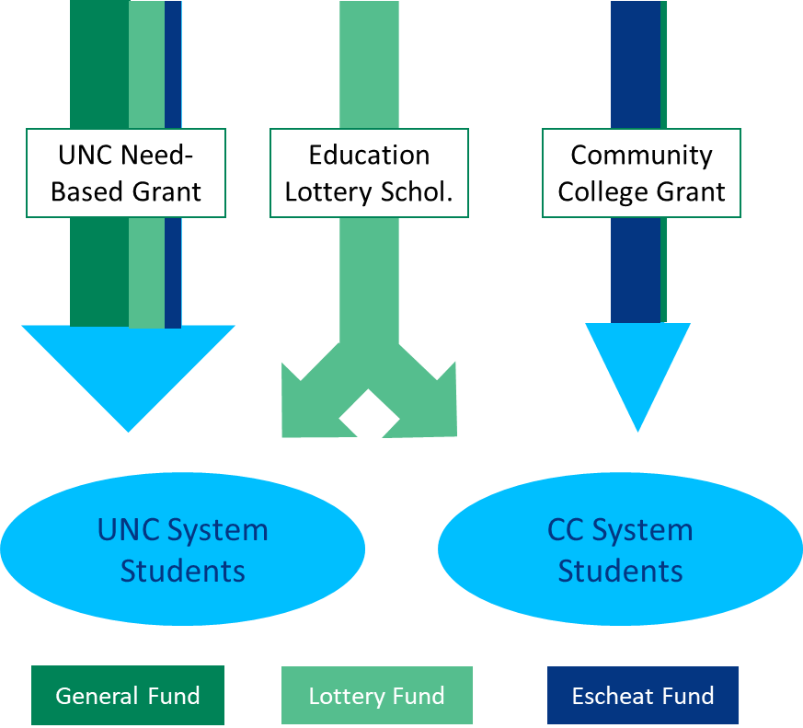
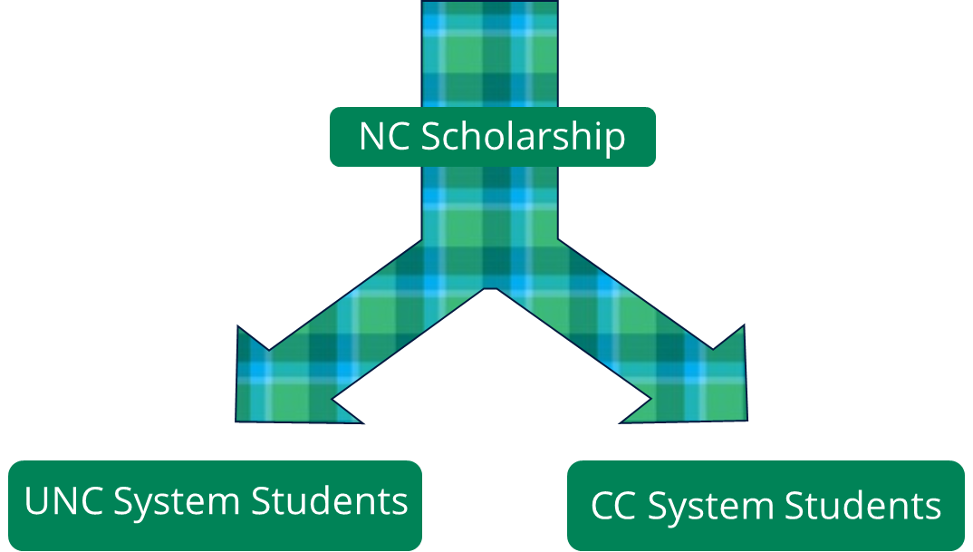
RECOMMENDATION: SIMPLIFY
Study Group Recommendation
Consolidate state’s three public need-based grants into one program
Allows students and families to understand options and eligibility earlier
Approved in 2021 State Budget
BEFORE
AFTER

Slide 7
NEXT NC SCHOLARSHIP 2024-25
Most NC students with AGI < $80K will qualify for at least $5K to attend a UNC institution and $3K to attend a NC community college
File a FAFSA to apply
ADJUSTED GROSS INCOME <$75,00 EXPECTED FAMILY CONTRIB < $7,500
How it works:
Combines federal Pell Grants and state funds to ensure students get at least the minimum awards of $5,000 for UNC and $3,000 for NCCCS
Eligible students have AGI < $80,000 and SAI (federal need calculation) < $7,500
More aid is available based on need

Slide 8
FREE APPLICATION FOR FEDERAL STUDENT AID FAFSA

Slide 9
FAFSA DELAY AND IMPACTS
Launch of 2024-25 FAFSA delayed from Oct. to Jan.
Technical issues with FAFSA completion for students
Student record data shared more than 6 months late
Student record data initially incorrect
Seeing signs of improvement

Slide 10
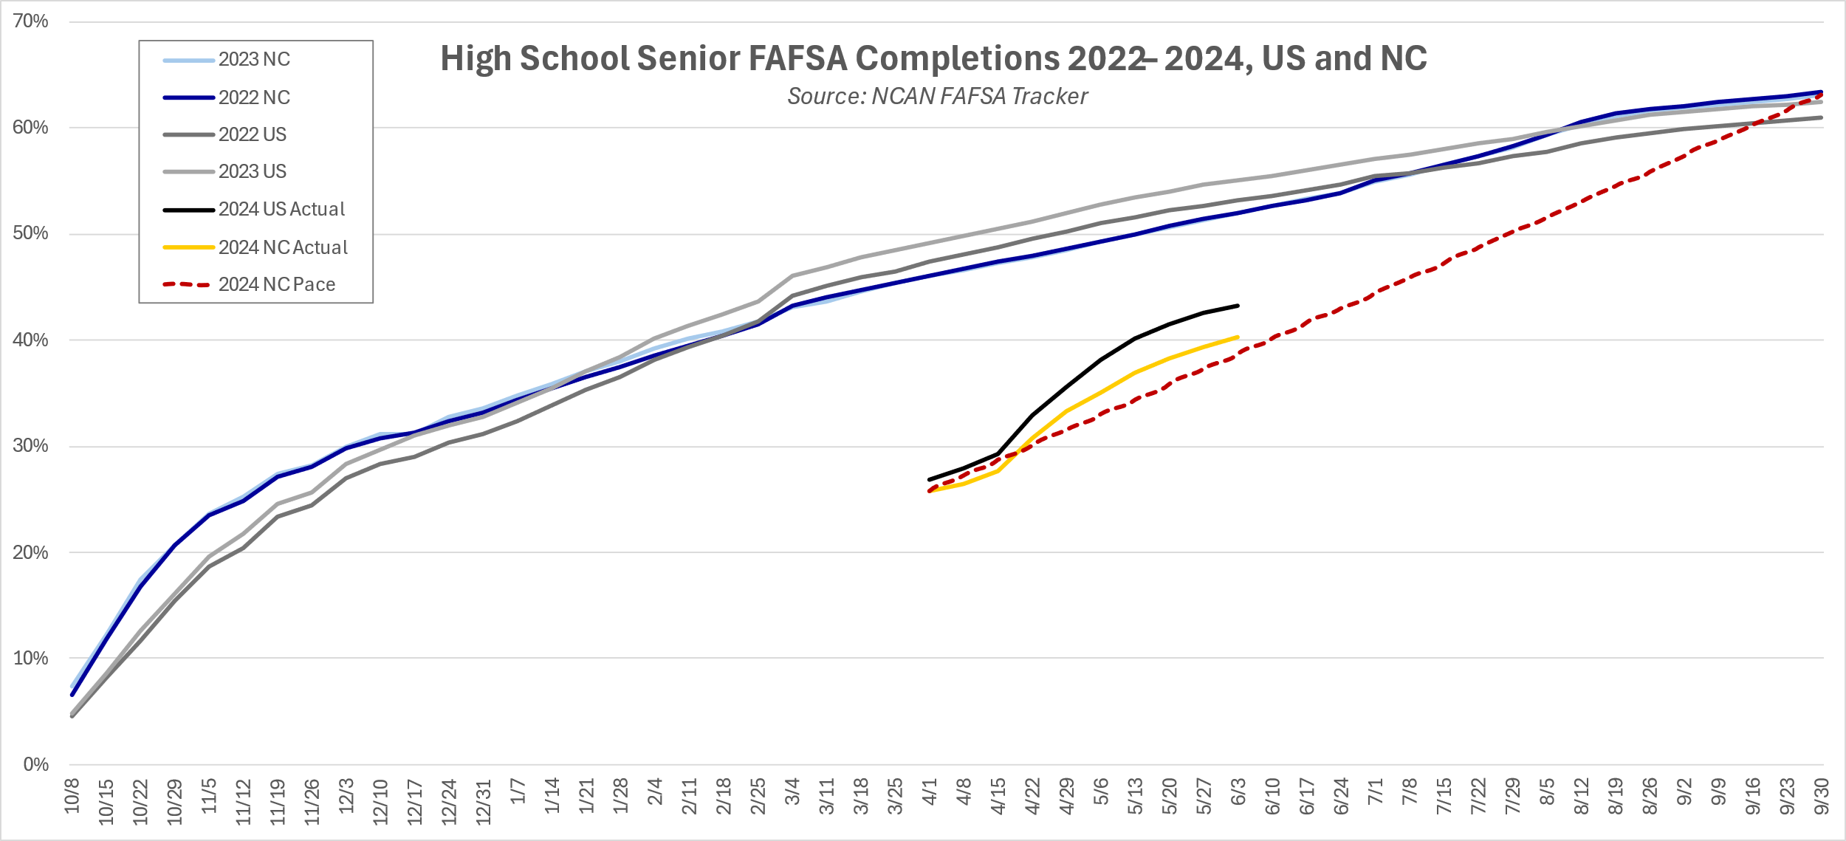
NC FAFSA COMPLETIONS: How are we doing?
14% decrease from this time last year
38% decrease from this time last year

Slide 11
FAFSA RESPONSE AND
NEXT NC SCHOLARSHIP

Slide 12
FAFSA RESPONSE TO DATE
Research-based Next NC Scholarship public awareness campaign focuses on FAFSA completion
Created NC FAFSA Hub with FAFSA resources for education professionals
Statewide FAFSA Day in January with over 60 institutions and 1,500 students participating
“How to Pay for College” webinars during Financial Aid Awareness Month in February
Updated NC FAFSA Tracker, which shows state, district, and school-level FAFSA completion information

Slide 13
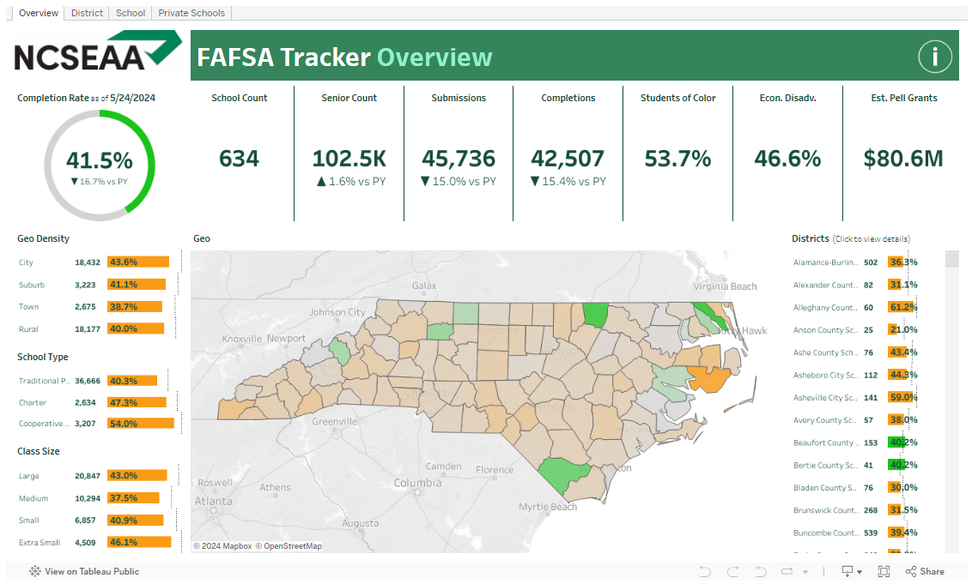
NEW NC FAFSA TRACKER: cfnc.org/fafsatracker
New NC FAFSA Tracker provides high school FAFSA completion information for the state, as well as by district and school

Slide 14
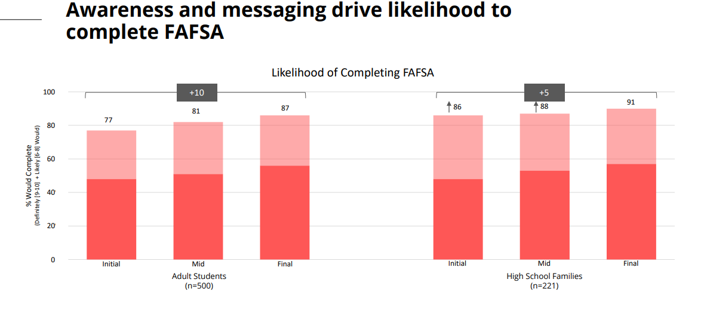
NEXT NC RESEARCH

Slide 15
NEXT NC RESEARCH

Slide 16
NEXT NC WEBSITE: www.nextncscholarship.org

Slide 17
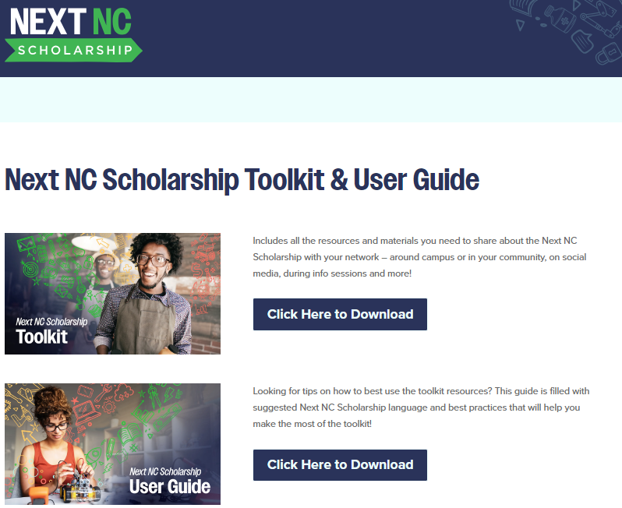
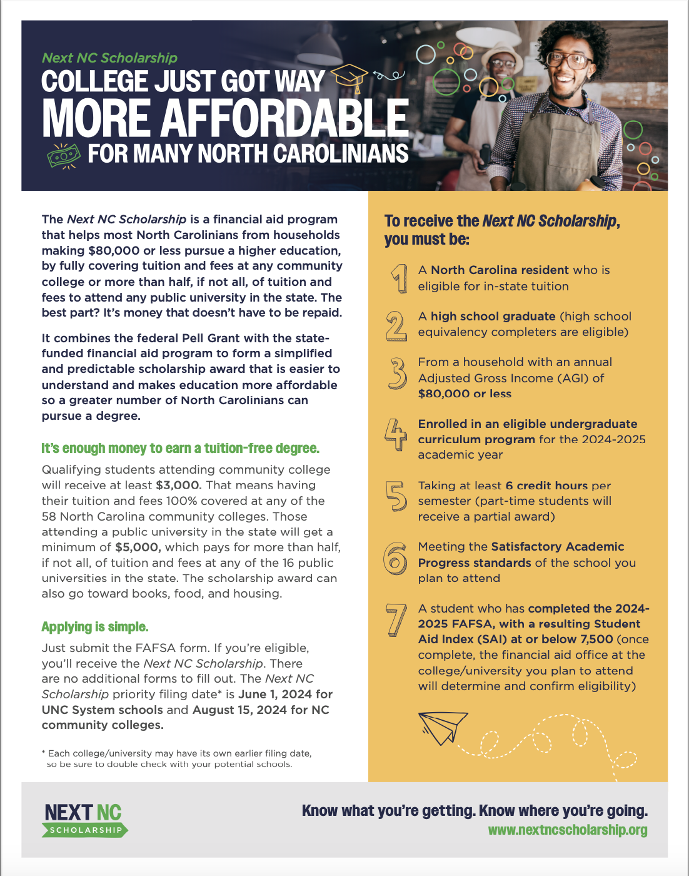
NEXT NC TOOLKIT: www.nextncscholarship.org/toolkit/

Slide 18
WHAT’S NEXT
Working with partners on a FAFSA completion campaign in late spring and summer, including:
Graduation toolkit with Next NC Scholarship and FAFSA information
FAFSA completion mini-grants to community college from John M Belk Endowment
Next NC Scholarship mailer and emails
Billboards
1:1 student support stationed at CCs and
UNCs across the state

Slide 19
QUESTIONS?

